Slide 1
Gift Card Landscape & Competitive Report
July 2012

Slide 2
Table of Contents
The Gift Card Industry…………………………………………… 3
Gift Card Vendors Competitive Report………………….. 7
First Data…………………………………………………………. 8
GETI…………………………………………………………………. 9
Paytronix.………………………………………………………. 10
Profit Point.…………………………………………………… 11
Signature Card.……………………………………………… 12
Valutec.……………………………………………………….... 13

Slide 3
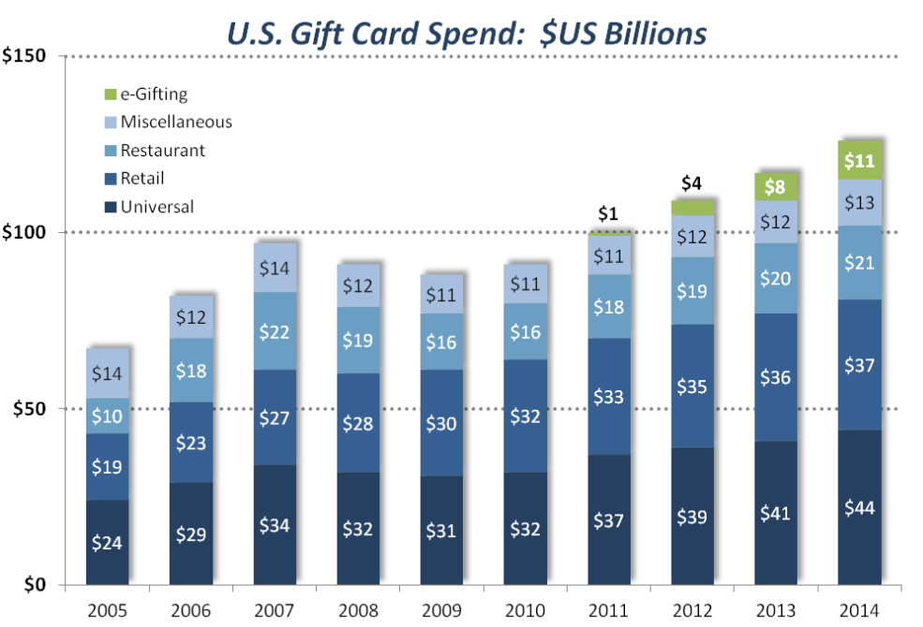
Gift Card Industry
Gift card spending topped $100 billion for the first time ever in 2011
Expected to reach $130 billion by 2014
Consumers realizing more value from their gift cards due to the Credit Card Accountability, Responsibility, and Disclosure (CARD) Act of 2009
Extended or eliminated many card expiration dates
Removed many junk fees
Source: http://www.prnewswire.com/news-releases/the-power-of-plastic---gift-cards-to-surpass-100-billion-in-2011-sales-135915223.html

Slide 4
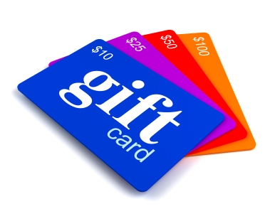
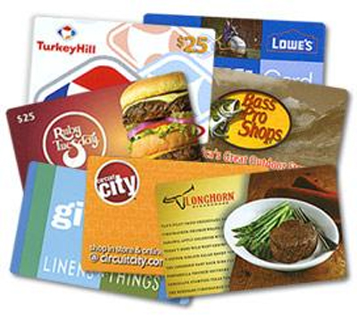
Understanding Gift Cards
2 Major Gift Card categories:
Open-Loop: card issued by banks or credit card companies and are redeemable by any retailer
Closed-loop: merchant-branded gift cards issued by retailers for use exclusively with that retailer
Very rarely have dormancy or maintenance fees, or expiration dates
Applicable for Swipely’s purposes
Source: http://www.creditcards.com/credit-card-news/gift-card-survey-2011-ecards-digital-1271.php

Slide 5
Gift Card Factors
Gift cards carry a variety of options and characteristics that brands must consider when offering them to customers. They include:
No expiration date
No dormancy or maintenance fees
Card and/or funds replaces after loss or theft
Reloadable?
eCard availability
Online balance check
Source: http://www.creditcards.com/credit-card-news/2011-gift-card-comparison-table-1271.php

Slide 6
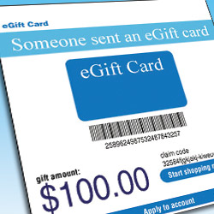
Future of Gift Cards: E-cards
The popularity of E-cards is expected to skyrocket in the coming years as more and more major brands adopt them.
2011 E-card spending = $1 billion
Expected 2014 E-card spending = $11 billion
E-cards can be gifted through:
E-mail
Mobile apps
Social media
Challenges to E-gifting:
Many customers still like holding a physical card in their hands
Merchants need to catch up to the technology
Source: http://www.creditcards.com/credit-card-news/gift-card-survey-2011-ecards-digital-1271.php

Slide 7
3rd Party Gift Card Vendors Competitive Report

Slide 8
Gift Card Vendors Search
Google Search
BuyerZone.com referrals
Individual merchant and ISO referrals

Slide 9
First Data
The case for First Data:
Store-branded cards with option for custom designs and promotions
Enhanced features including online and 3rd-party sales
Automated setup, fraud protection, and financial and marketing reporting
Flexible gift card packages for merchants to select from
Swipely already has relationship with the company; could link any gift card with First Data system already in place at Swipely merchants

Slide 10
Global eTelecom Inc. (GETI)
The case for GETI:
Option of template cards or custom-designed cards for merchants
Cards compatible with nearly all POS credit card terminals, GETI virtual terminal, and 3rd party payment gateways
Allows resellers to brand all transactions so it appears Swipely is running the program while GETI remains transparent
Offers resources like giftcardtraining.com for resellers and merchants
E-card capabilities

Slide 11
Paytronix
The case for Paytronix:
Real time reports and analysis on gift card sales
Integrates gift card sales opportunities with leading third party gift card channels
Option of selling cards on merchant’s website
Product-on-a-Card option: placing menu items rather than dollar amounts on a card
Flexible solutions to integrate with any POS system; company prides itself on smooth transition to Paytronix solutions

Slide 12
Profit Point
The case for Profit Point:
Maintains overall database of all gift card usage
Tracking in up to 40 fields of demographic info
E-cards and mobile gifting available
Virtual terminal cloud processing option anywhere with Internet
Compatible with nearly all major terminals, but not as many POS systems

Slide 13
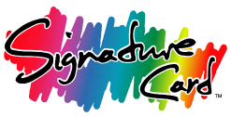
Signature Card
The case for Signature Card:
Specializes in custom card design
Prints, encodes, and places image on cards
Tracks statistics and reports data based on card usage
No transaction fees
Wide variety of POS integration options and experience working with First Data merchants

Slide 14
Valutec
The case for Valutec:
Complete in-house merchandising, card design, and production services
Largest provider in the small to mid-size merchant space
Option of Referral Partnership or Reseller Partnership
Referral: Connect merchants with vendor and Valutec handles all the steps in the process; Swipely earns commission for the closed deal and residuals
Reseller: Swipely responsible for completed sale and merchant sign-up; reseller held responsible for all merchant payments
Compatible with a wide variety of terminals and POS environments

Slide 15
Actionable Issues
Function as a referral partner or a reseller
How involved in the gift card process does Swipely want to be?
Focus on compatibility through credit card terminals or POS systems (or both)
Should each individual merchant make the decision or should all Swipely gift cards function the same way?
Continue to develop relationships with Sales Reps. from various vendors and learn more about potential partnerships
Narrow the field to top three choices and explore them further

Slide 16
Vendor Web Sources
First Data
firstdata.com
http://www.firstdata.com/downloads/marketing-merchant/giftcardsalessheet.pdf
http://www.firstdata.com/downloads/marketing-merchant/giftcardprogrambrochure.pdf
GETI
www.globaletelecom.com
http://www.giftcardtraining.com/docs/general/Gift_Program_Description.pdf
Paytronix
www.Paytronix.com
http://www.paytronix.com/CompleteSectionPDFs/Gift.pdf
Profit Point:
http://www.profitpoint.com/
http://www.profitpoint.com/content/gift-card-programs
Signature Card:
http://www.signaturecard.net/
http://www.signaturecard.net/gift-card-systems
Valutec:
http://www.valutec.net/
http://www.valutec.net/html/ready_to_order_giftcards1.html?utm_source=google&utm_medium=cpc&utm_campaign=G20&utm_term=gift+cards&utm_content=ready4&gclid=CPvXnMj1nrECFUlN4AodUHgFWA

