Slide 2
me

Slide 3
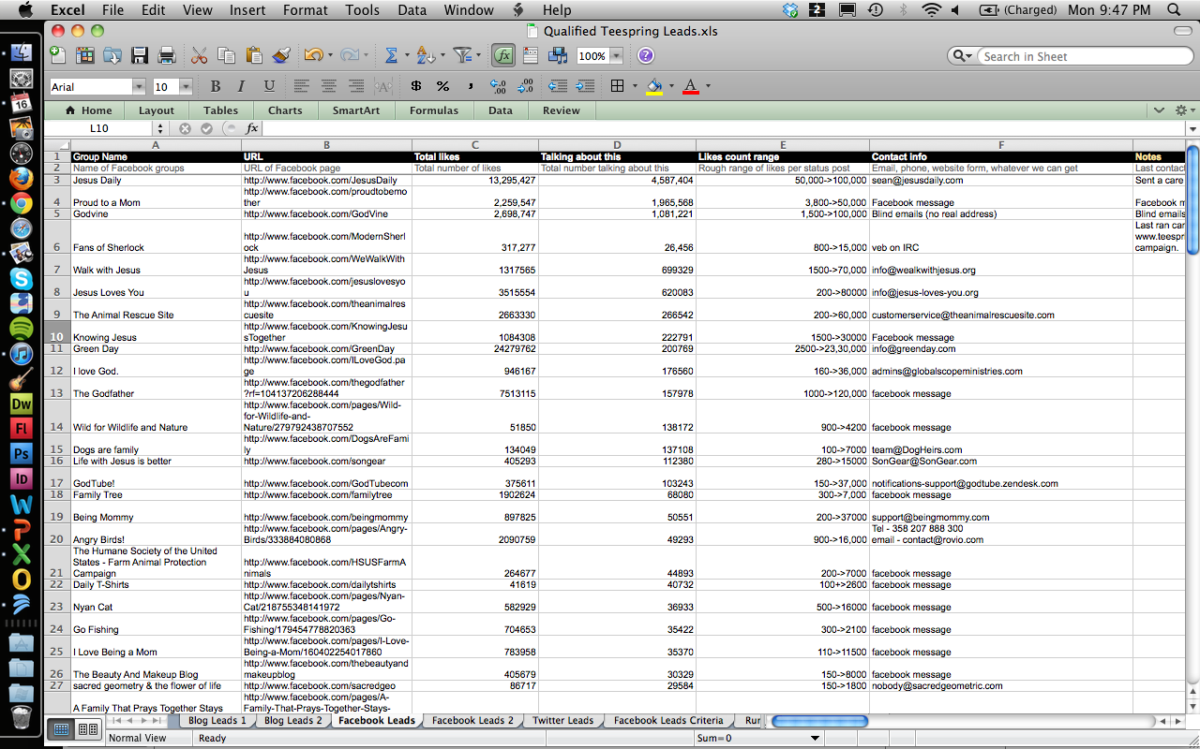

Slide 4
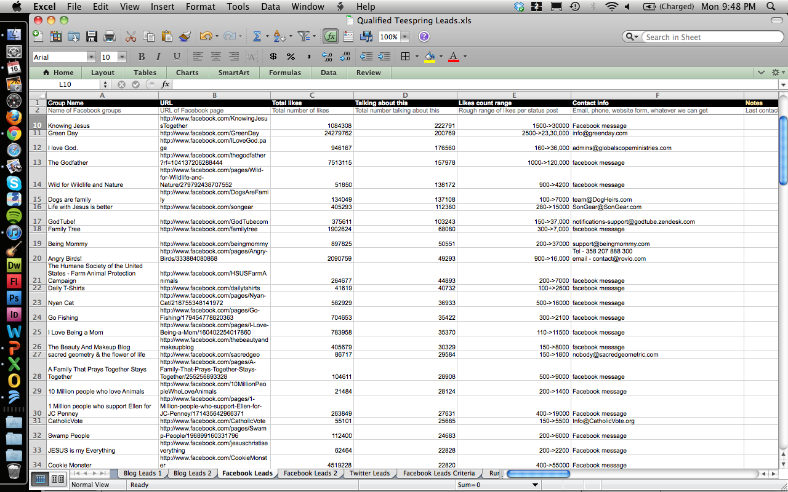

Slide 5
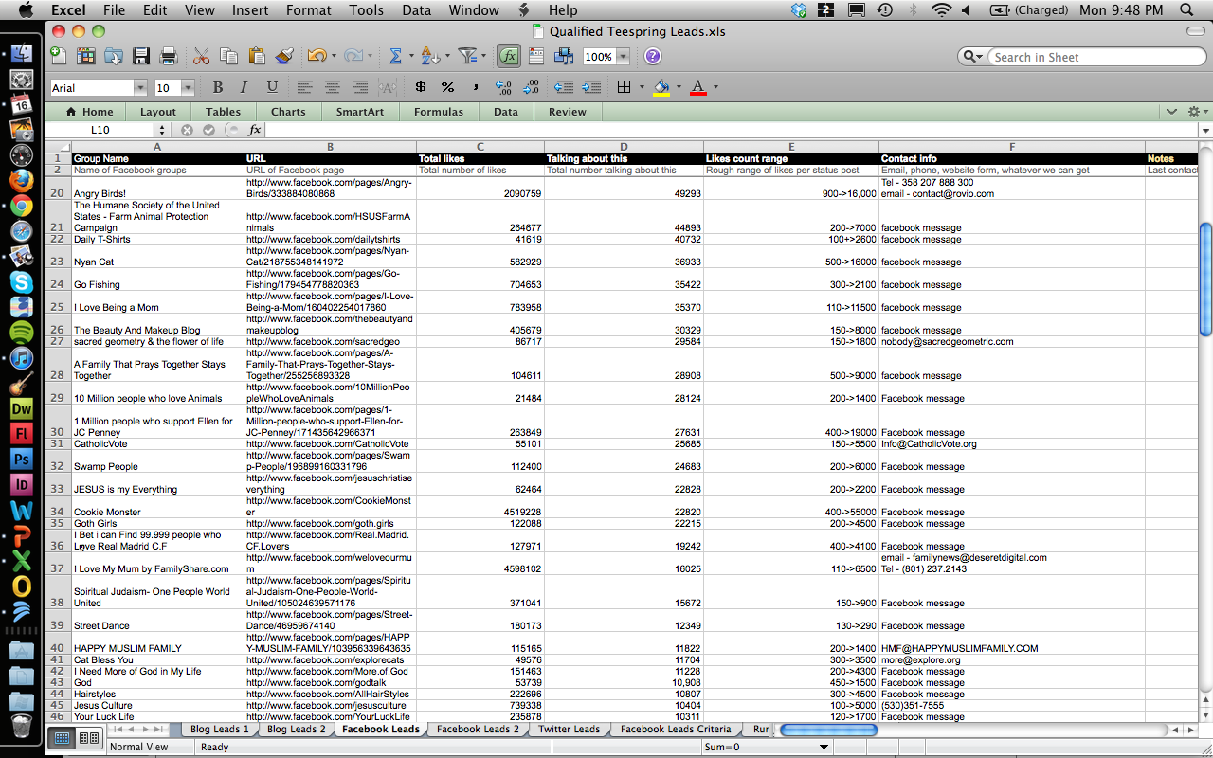

Slide 6
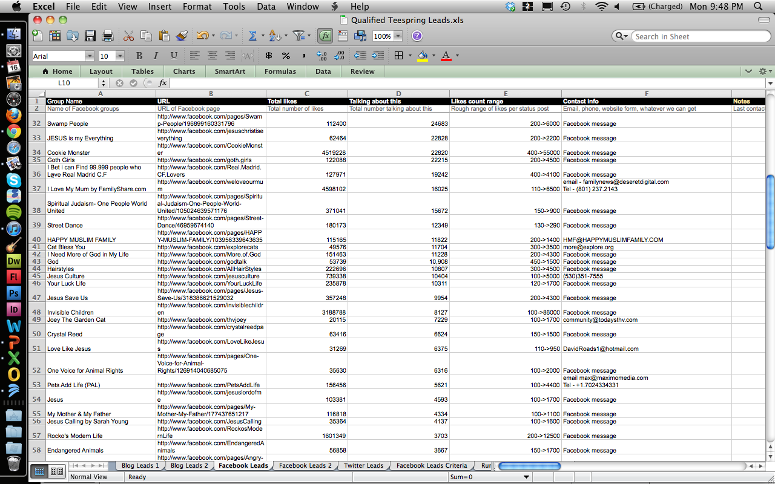

Slide 7
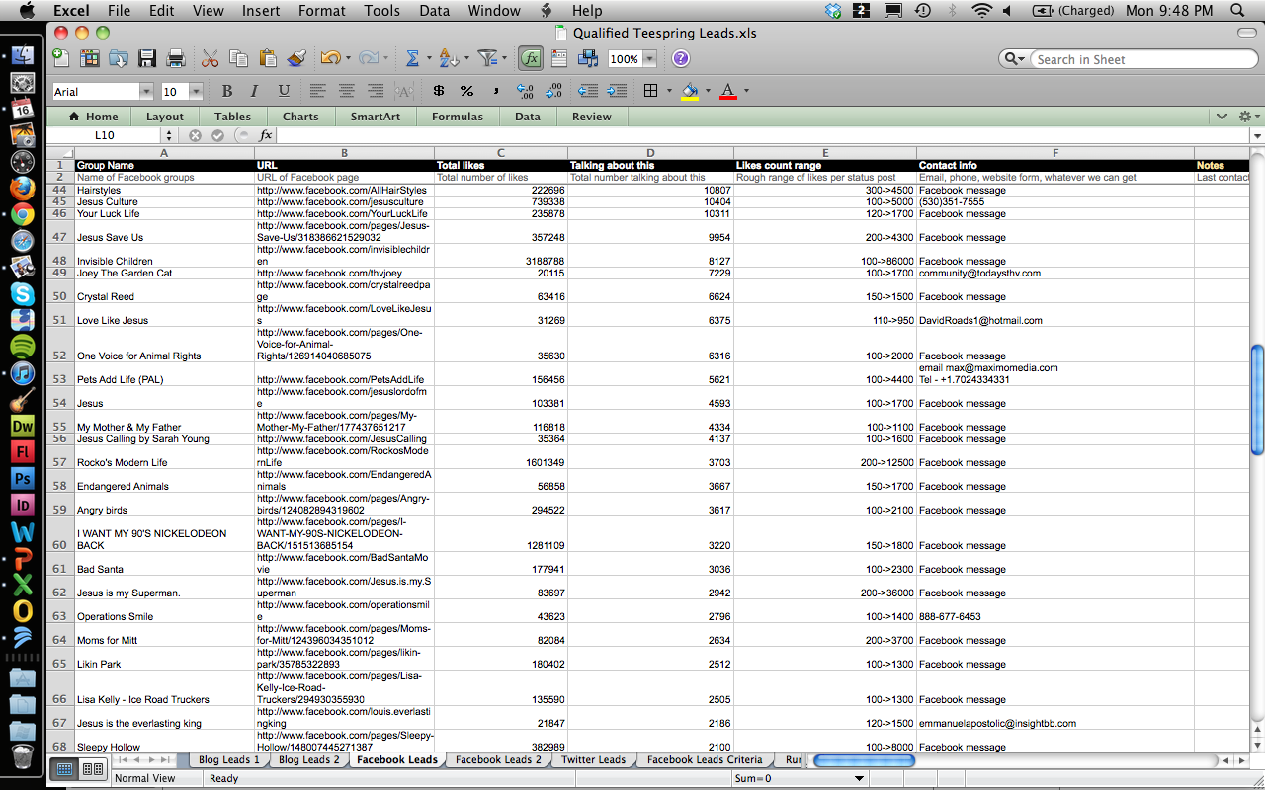

Slide 8
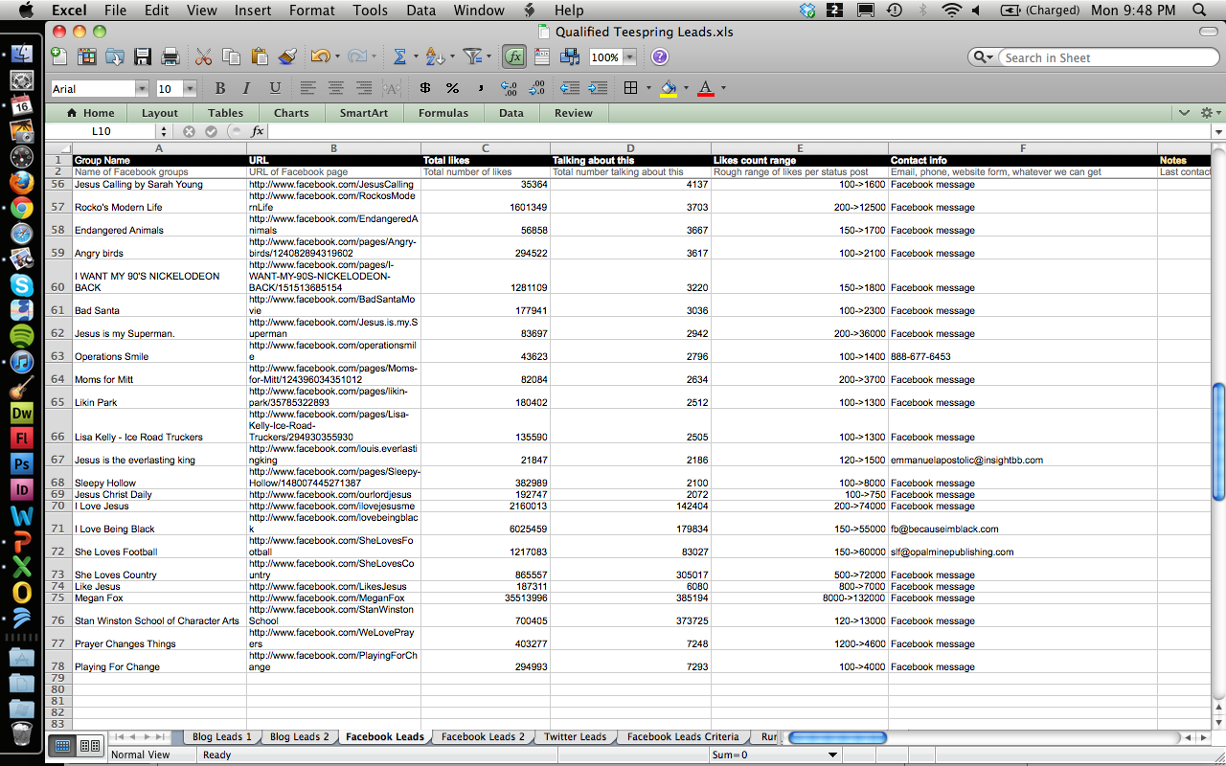

Slide 16
communities
causes

Slide 17
# of likes
communities
causes

Slide 18
# of followers
# of likes
communities
causes

Slide 19
# of followers
# of comments
# of likes
communities
causes

Slide 20
PRIORITIZE
LEAD SCORES

Slide 21
what’s a lead score?

Slide 22
what’s a lead score?
data

Slide 23
what’s a lead score?
data
+ algorithms

Slide 24
what’s a lead score?
data
+ algorithms
= lead score

Slide 25
what’s a lead score?
data
+ algorithms
= lead score
(thanks kathy!)

Slide 26
what’s a lead score?
data
+ algorithms
= lead score

Slide 27
what’s a lead score?
data
+ algorithms
= lead score

Slide 28
what’s a lead score?
data
+ algorithms
= lead score
higher = stronger lead

Slide 29
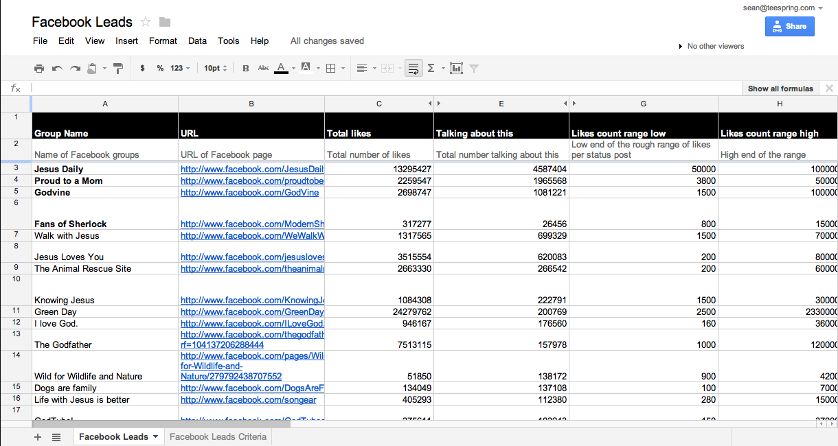

Slide 30
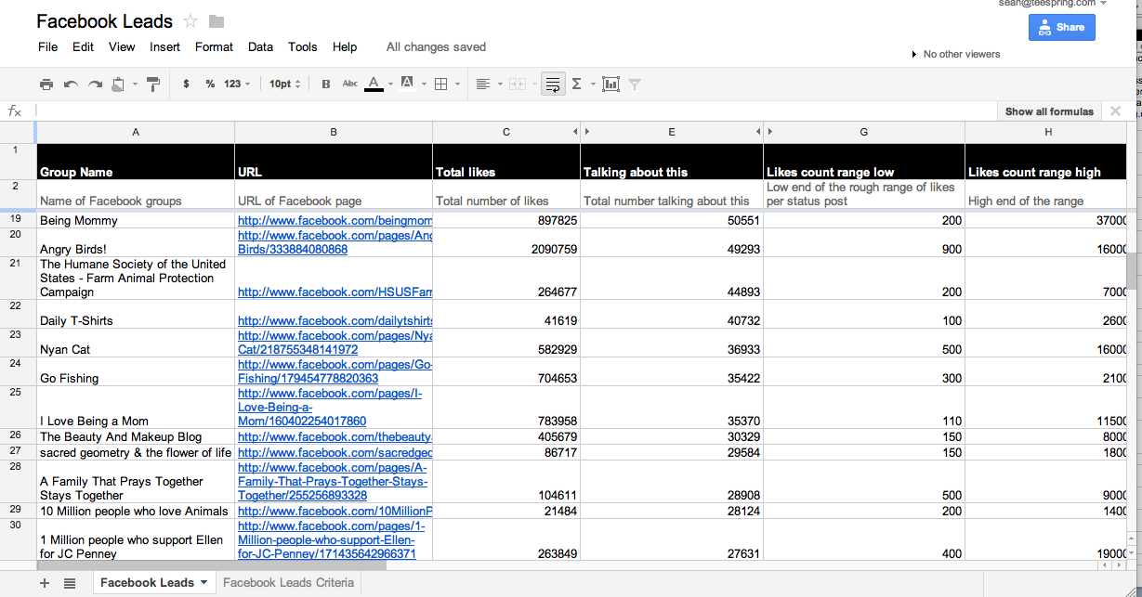

Slide 31
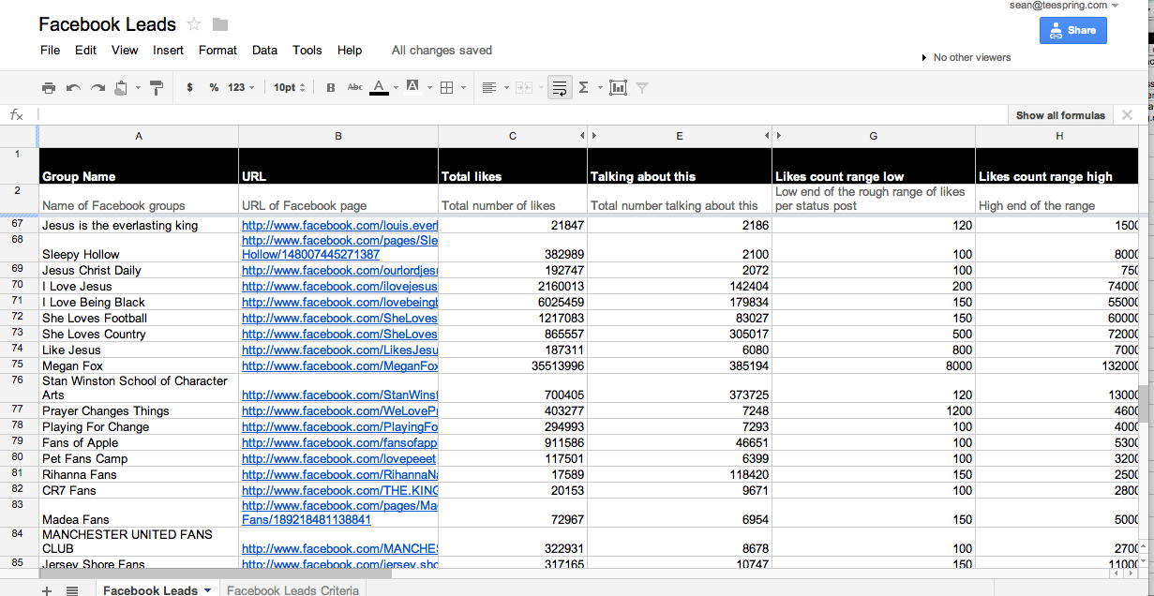

Slide 37
thanks!

